Slide 1


…SWEETENING THE NHL FAN EXPERIENCE ™
Product Walkthrough
2011
1

Slide 2


Confidentiality Agreement
The reader and or recipient of this presentation acknowledges that the information provided by FanCandy. (“the Company”) herein constitutes confidential, proprietary, trade secrets of FanCandy, other than information which is in the public domain through other means. The reader also acknowledges that that any disclosure or use of same by reader may cause serious harm or damage to FanCandy.
This presentation may not be copied, faxed, reproduced, emailed, or otherwise distributed and the contents of this presentation may not be disclosed in any manner by the reader without the Company’s express written consent.
The information in this presentation is inherently forward-looking information. Among other things, the information: (1) discusses the Company’s future expectations, (2) contains projections of the Company’s future results of operations or of its financial condition, (3) states other “forward looking” information. There may be events in the future that the Company cannot accurately predict or over which the Company has no control, and the occurrence of such events may cause the Company’s actual results or capitalization requirements to differ materially from the expectations described herein.
Upon request, this document is to be immediately returned to FanCandy if in hardcopy and/or immediately destroyed if in electronic format

Slide 3

Introduction
THE NEXT BIG THING
FOR CORE AND CASUAL NHL FANS (example)

Slide 4
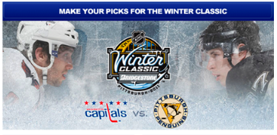

Introduction
Business Purpose:
To create a compelling prediction game for
for hockey in 2011
Powered by

Slide 5
Goals of Partnership
Differentiated Content
achieved through FanCandy’s unique prediction game features such as the “FanFactor” and real-time propositions
Engagement
achieved through the FanCandy game mechanics and prestige-based competition
Revenue Generating Products/Services
achieved through multiple monetization techniques and business models
Drive new viewers for NHL
achieved through the game’s draw power and social features

Slide 6
Strategic Alignment
FanCandy with TV Partner:
To create an NHL product that integrates with and adds to content
To offer an NHL fan-centric experience for sports enthusiasts
To create unique content available exclusively on TV Partner
To develop a multi-sport game platform to extend viewer engagement TV Partner pre, during, and post-event for NHL
To create a vehicle for TV Partner viewers to seek digital engagement with TV Partner
To provide a “pitch and catch” relationship between NHL programming and TV Partner content

Slide 7
Strategic Focus
FanCandy is a logical extension of Fantasy Sports and Chat:
-Predictions are a unique way of creating connections with fans;
-The game’s social feature will draw new users to TV Partner
The FanCandy prediction game is a perfect addition and complement to TV Partner content

Slide 8
Metrics of Success
To drive existing viewer engagement for all NHL games
To drive viewership of additional games on schedule
To keep viewers watching longer during each NHL telecast
To create additional advertising revenue for TV Partner
To create additional revenue streams for TV Partner
To create a path to micropayments and other revenue streams for TV Partner

Slide 9
FanCandy Game Tactics
Pre-Game Propositions
  Heightens game broadcast anticipation
Real-Time Propositions
  Ties directly to telecast - deepens engagement
  “Pitch and Catch” with TV Audience
Leaderboards
  Drive for prestige creates competition
  “Reason to Care”
Social Features
  Communication creates Community
  Creates engaging context for viewing
  “Sweetening the NHL fan experience ”

Slide 10
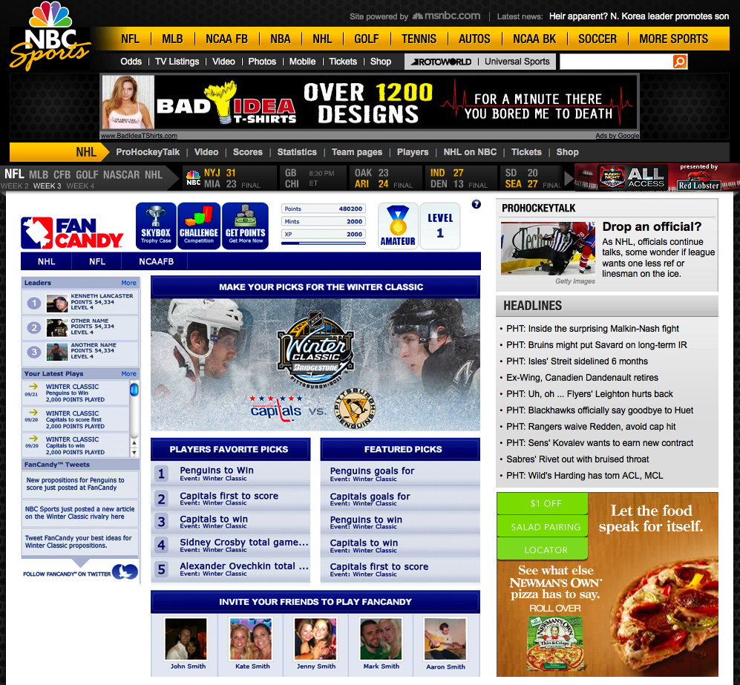
Game Mechanics
Online Game
Free to Play
Start with 2,000 Points
Predict the Winning Proposition
Gain Status on Leader Board
Daily, Weekly and In-Game Challenges

Slide 11
Consumer Engagement Tactics
Leader Boards
Smack Talk
Increase Time on Site
Increase Page Views
Increase Ad Opportunities
Social - Twitter, Facebook & Smack Talk

Slide 12
Advertising and Sponsor Attractions
Around Game Media
Ad / Sponsors
Pre-Roll Video Support
Around App Display Ads
Sweeps & Prizing
Sponsorships
Pre Roll Video
Around Game Media

Slide 13
Proposed Technical Environment Mockup
Game to run within TV Partner
TV Partner to control ad content and placement
TV Partner to provide hosting and support (FanCandy will host and support under contract if desired)

Slide 14
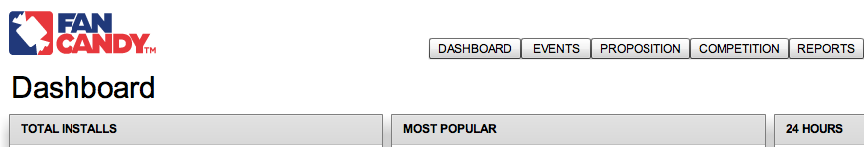
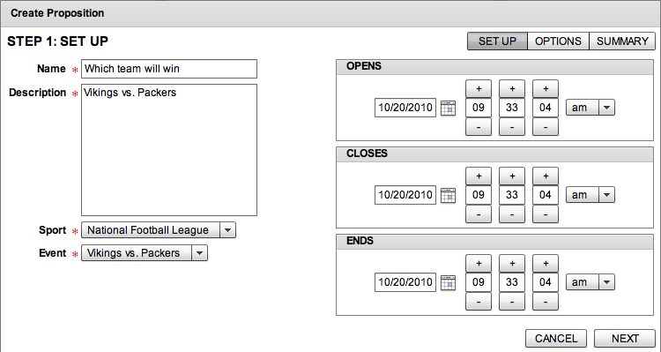
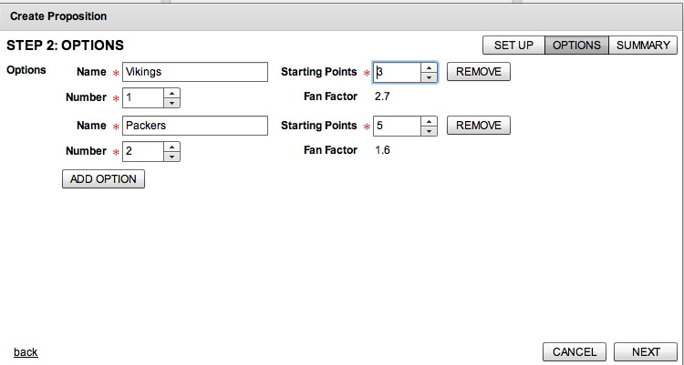
Game Administration
TV Partner FanCandy Dashboard
Turn-Key App
Reporting & Analytics
Client Dashboard Control Proposition Creation
Real-Time Propositions
Two step process

Slide 15
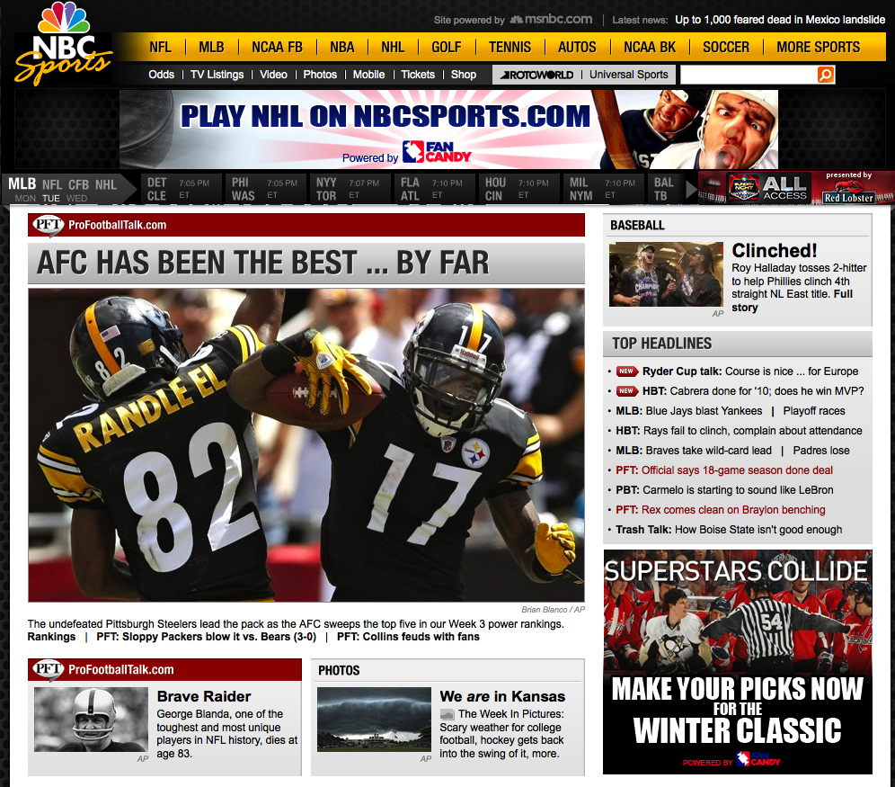
Proposed Business Model
Proposed Business Model
License
Customization fees
Bonus charge: Revenue share of advertising/sponsorship

Slide 16
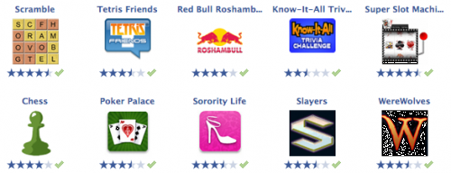
Legal Environment
FanCandy Games
Social Games -- Not Gambling

Slide 17

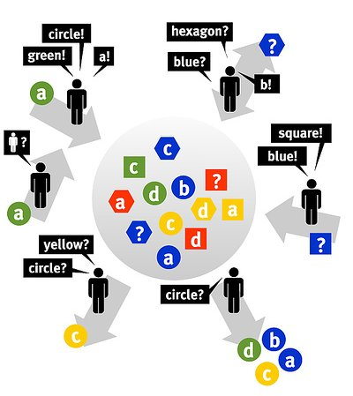
Core Game Concept
Make Game Predictions
using
Virtual Currency
Play for Bragging Rights and Prestige
For Bragging Rights and Prestige
Social TV Experience
Wisdom of Crowds Tech. Creates Odds

Slide 18
Consumer Positioning
FanCandy
Sweet Spot
Live TV Viewership
Second Screen
Engagement
>40% of TV event viewers engaged in second screen experience
Social TV Experience
Reach out to friends/family before, during and after the game

Slide 19
FanCandy Management Team
Greg Lewis: Founder & CEO
  A two-time national EMMY honoree, Lewis brings more than 30-years experience as a media executive and TV producer, in addition to relationships in network TV (NBC, CBS, ABC/ESPN, HBO, Showtime, Turner, Versus) broadband and mobile media to FanCandy Inc. He regularly conducts business with America’s major league sports, the IOC, and numerous international sports federations. Lewis is a graduate of Middlebury College.

Slide 20
FanCandy Management Team
Steve Tucker: GM of Games
  Mr. Tucker's backgroubcd includes consulting & positions with Atari, Inc. (interactive entertainment & video games) leading their business operations & product marketing efforts, Games2Win, Inc. (a top 20 online / social games, iphone apps, virtual worlds, digital entertainment company) supporting their business development into North America & European markets including IP acquisition, ad sales, distribution and partnerships, Worldwide Biggies, Inc. (a digital entertainment studio - film, interactive content, TV, webisodes, social media) acting as their Chief Revenue Officer for multi-platform revenue generation and product innovation, IGA Worldwide, Inc. (leading in-game advertising firm) driving their global in-game sponsor / brand integration division, Apple (computer / technology) establishing operations for emerging market business units, Deloitte & Touche - consulting in entertainment and technology practices, among other tech, media and entertainment firms / projects for business to business & business to consumer programs.
  Mr. Tucker earned his BS in Industrial Management from Clemson University in Clemson, SC and his MBA, Cum Laude from The University of North Carolina - Charlotte.

Slide 21
Board of Advisors
Tom Reddin:
  Reddin is the former CEO of LendingTree.com., and now runs Red Dog Ventures, a venture capital company focused on helping start-up and early stage companies get to the next level of growth. Previously, he was CEO of Richard Petty Motorsports, a top five NASCAR team; spent seventeen years in the consumer packaged goods industry, including five years at Coca-Cola USA, where he ran the Coca-Cola brand as Vice President, Consumer Marketing.
Kartik Ramachandran
  Ramachandran is an Entrepreneurial Telecom and Media & Entertainment professional, specializing in deal structure and execution, digital media operations management, new media business development, corporate and venture development, fundraising, media technology assessment, mobile content, and interactive gaming and interactive media. He is Sr. Director, Investor Relations at Activision Blizzard, Inc., and previously did private equity & tech/media/telecom strategy, Bain & Co.; strategy & corporate development, QUALCOMM Inc.; securities analyst/equity research, Deutsche Bank Securities, Inc.; management consulting, Accenture, Inc.
Steve Keech
  Keech is president of AmTote International, Inc., the leading totalisator technology and services provider for domestic and international parimutuel operations. Previously, Keech was Chief Information Officer at Magna Entertainment, and a Senior Manager at BearingPoint, responsible for the delivery of solutions to the Telecommunications and Entertainment industry for Canada

Slide 22
Board of Advisors
Marc Zwillinger
  Zwillinger’s legal practice has focused on the Internet space since 1997, first as a computer crime prosecutor at DOJ and for the last seven years as the Global Practice Chair of Internet, Communications and Data Protection Practice at Sonnenschein, Nath & Rosenthal. The founder of Zwillinger Genetski LLP, he specializes in information security, data privacy, Internet gambling, unfair and deceptive trade practices, surveillance and wiretap laws, ECPA, FISA, CAN-SPAM, Computer Fraud and Abuse Act, adult content.
Ty Braswell
  Braswell is the consultant for Mobile Strategy at the National Hockey League. Previously he was a Vice President at Sony Corporation of America; and Vice President, Virgin Records. Braswell founded and leads Creative Digital Strategies, a boutique consulting practice, advising clients in wireless/mobile marketing, interactive advertising, and digital strategy development for “third screen” projects.
Mike Wheeler
Wheeler is Managing Partner of Westerly Partners, an Investment Advisory that provides strategic, financial, and technology solutions to early stage companies focused on the new media and technology industries. Previously, Wheeler was President CNB/Dow Jones Desktop Video; EVP NBC New Media; COO, Financial News Network; SVP National Accounts, Showtime/Viacom; and Regional VP Affiliate and Advertising Sales, MTV Networks.

